Slide 1
From Keyword-based Search to Semantic Search, How Big Data Enables That?
Site Technology TOI Fest
Q1 2015 Celebration

Slide 2
Outline
Introduction
Required Data Sources
Big Data Platform
Semantic Search at CB
Future Work and Conclusions

Slide 3
Introduction

Slide 4
Keyword-based Search
Traditional search engines (i.e. Lucene, Solr, Elasticsearch) tokenize text and find documents containing those tokens and linguistic variations:
User’s Search: machine learning Tokenization: ["machine", "learning"] => Stemming: ["machin", "learn"] Final Query: machin AND learn
This could match a document for a “machinist” who has “learned” something.
software architect => … => software AND architect
Might identify a building architect requiring knowledge of specialized architecture software
account manager => … => account AND manage
Will match text such as “need to manage the process and account for any variances”

Slide 5
Semantic Search
We need a way to identify and search for the meaning of keyword phrases, not just the individual text tokens
i.e. machine learning = "machine learning" OR "data scientist" OR "mahout" OR "svm" OR "neural networks”

Slide 6
Possible Solutions
Natural Language Processing (NLP)
Not a good option for CB (different languages)
Statistical ML Models
Language-agnostic
Human-readable
High accuracy
Fast and scalable
Manual Taxonomies:
Not Scalable
Man power required in every supported language

Slide 7
Required Data Sources
search logs (Billions)
Job Seekers
Recruiters
Classified users (Millions)
Black-listed keywords (e.g stopwords)

Slide 8
Big Data Platform

Slide 9
Hadoop Platform
Distributed storage and processing platform
Scalable to Petabytes or greater
Our clusters:
Production:
68 DataNodes.
~800TB configured, over 600TB used (replication factor 3),
mostly compressed data.
Combined ~1400 CPU threads, ~4TB RAM.
DR:
42 DataNodes, 1.4PB.
SQL Server tables refreshed daily
Table data stored as SequenceFile format (binary, compressed)
Looking into row-column store formats

Slide 10
Processing on Hadoop
MapReduce (Java)
Distribution of work (map)
Aggregation of work output (reduce)
Hive: SQL-like language
Sqoop: Transfer of data between HDFS and relational DBs
Oozie: Workflow management, scheduling HDFS operations, MapReduce, Hive, Sqoop

Slide 11
Cont..
Q2: Spark (Java, Scala, Python, etc.)
Will still support MapReduce, but Spark is the future.

Slide 12
CB Semantic Search

Slide 13
Our Target
User’s Query: machine learning research and development Portland, OR software engineer AND hadoop java
Traditional Search Engine Parsing: (machine AND learning AND research AND development AND portland) OR (software AND engineer AND hadoop AND java )
Ideal Parsing: "machine learning" AND "research and development" AND "Portland, OR” AND "software engineer" AND hadoop AND java
Semantically Enhanced Query: ("machine learning" OR "computer vision" OR "data mining" OR matlab) AND ("research and development" OR "r&d") AND ("Portland, OR" OR "Portland, Oregon") AND ("software engineer" OR "software developer") AND (hadoop OR "big data" OR hbase OR hive) AND (java OR j2ee)

Slide 14
Abstract Model
Mine user search logs
Collaborative Filtering
Remove noise

Slide 15
Job Seeker
Search Behavior
Recruiter
Search Behavior
Content-based Filtering

Slide 16
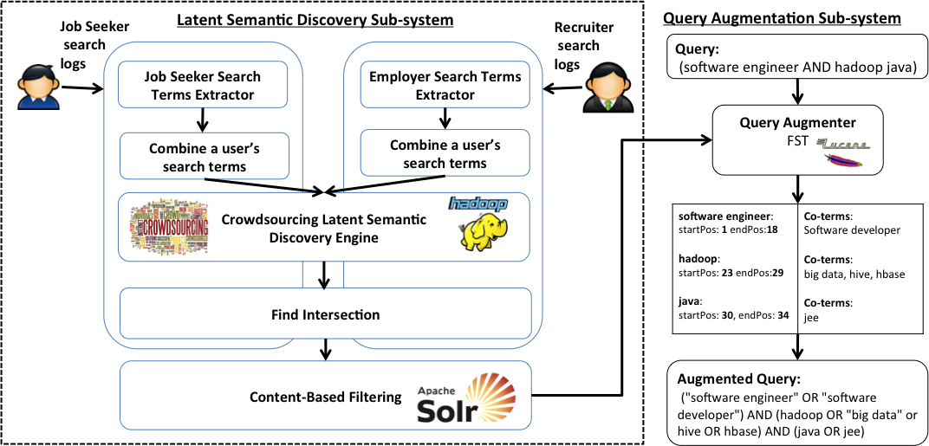

Slide 17
PGMHD
Java Developer
.NET Developer
Nurse
Health Care
3
10
2
1
50
10
5
50
100
15
Java
J2EE
C#
Care giver
RN
Senior Home

Slide 18
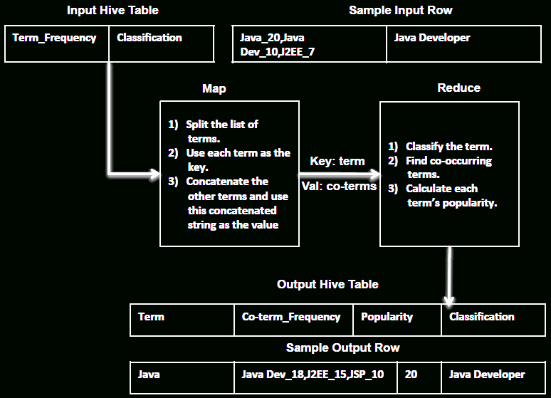
Map/Reduce job which finds and scores similar searches run for the same users
Jane searched for “registered nurse” and “r.n.” and “nurse”.
Zeke searched for “java developer” and “scala” and “jvm” and “j2ee”

Slide 19
Similarity Scores
Co-Occurrence Score
Point-wise Mutual Information Score
Probabilistic Based Similarity Score

Slide 20
Sample Results
Cashier => retail, retail cashier, customer service, cashiers
CDL => cdl driver, cdl a, driver
Data Scientist => machine learning, big data

Slide 21
Special Cases
Synonyms: cpa => Certified Public Accountant
rn => Registered Nurse r.n. => Registered Nurse
Ambiguous Terms*: driver => driver (trucking) ~80% driver => driver (software) ~20%

Slide 22
Conclusions and Future Work
Semantic Search focuses on understanding the meaning behind the search keywords.
Semantic Search at CB was enabled by implementing a workflow that analyzes billions of search logs using the Big Data platform.
The workflow runs continuously to handle any manually curation proposed by data analysts in near-real-time manner.

Slide 23
Conclusions and Future Work
We plan to start using Spark to analyze the queries we received in real time.
We plan to use semantic search API intensively in our recommendation engine to improve the quality of the recommendations

Slide 24
Acknowledgment
I would like to thank Trey Grainger for his continuous support to make semantic search possible and for providing the content of this presentation.
I would like to thank the Search Relevancy and Recommendations team who take the responsibility to build the API for this semantic search to make it useful.

Slide 25
Publication
Crowdsourced query augmentation through semantic discovery of domain-specific jargon, IEEE Big Data 2014

