Slide 1


Query Sense Disambiguation Leveraging Large Scale User Behavioral Data
By: Mohammed Korayem, Camilo Ortiz, Khalifeh AlJadda, and Trey Grainger

Slide 2



























Search Technology at CareerBuilder by the Numbers
100 million +
1,5 billion +
500+
30+
1
Searches per day
Documents indexed and searchable
Search Servers
Software Developers, Data Scientists + Analysts
Global Search
Technology platform
Powering 50+ Search Experiences Including:
...and many more

Slide 3

Agenda:
Problem Description
Proposed Solution
Experiment and Results
Conclusions

Slide 4



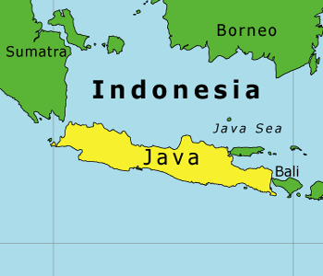
Problem Description:
Term Ambiguity can be defined as the challenge of having multiple potential meanings for a keyword.
Ex:
Java

Slide 5
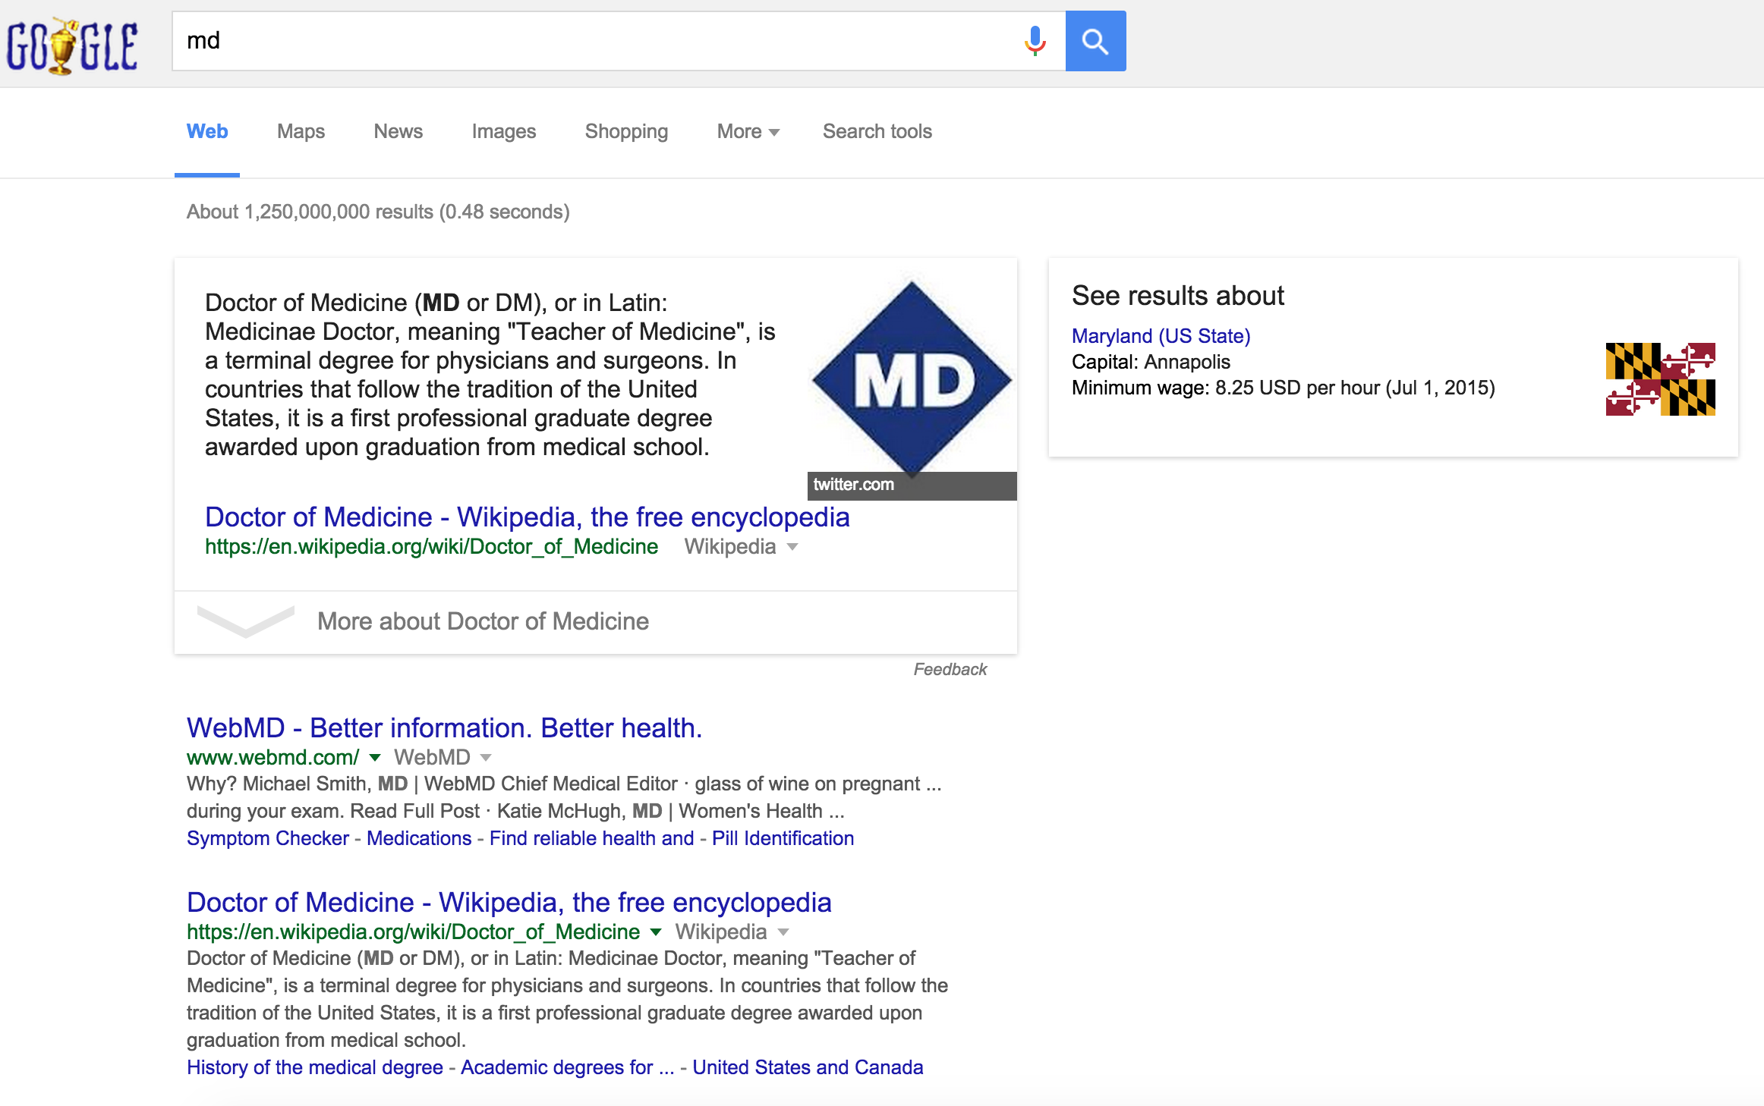

How Does Ambiguity Affect Search Engines?
Doctor of Medicine: Steps to Become a Medical Doctor
Maryland.gov - Official Website of the State of Maryland
Maryland - Wikipedia, the free encyclopedia
Doctor of Medicine: Steps to Become a Medical Doctor
Notes:
When it comes to recruiting, time is a luxury. Rely on our experienced team of project managers and nearly 20 years of job seeker data to drive your recruitment strategy – and find your ideal candidates quickly. We’ll scour the marketplace for the right candidates, pre-screen them, deliver the top ones to you – and put time back in your day.
Oh, and we don’t shop your top candidates around to other companies – so now’s your big chance to make your best first impression.

Slide 6
Why is it more challenging in queries?
“Java, lying between Sumatra and Bali, is a volcano-studded island that’s at the geographic and economic center of Indonesia, and home to more than half its people.”
“Java coffee refers to coffee beans produced in the Indonesia, mostly on the east side in the Ijen volcano complex on the Ijen Plateau at elevations around 1,400 meters.”

Slide 7

Proposed Solution:
Utilizing large scale user behavioral data (search logs).
Language-agnostic system.
Scalable, simple, and efficient.
Can easily handle domain-specific terms and meanings.

Slide 8
System Architecture
Notes:
When it comes to recruiting, time is a luxury. Rely on our experienced team of project managers and nearly 20 years of job seeker data to drive your recruitment strategy – and find your ideal candidates quickly. We’ll scour the marketplace for the right candidates, pre-screen them, deliver the top ones to you – and put time back in your day.
Oh, and we don’t shop your top candidates around to other companies – so now’s your big chance to make your best first impression.

Slide 9
Search Log Analyzer
collecting all the terms searched by each user when conducting queries against a search engine.
The semantic relationship between those terms is then extracted using PGMHD*
taking steps to aggressively remove noise from the query logs.
* K AlJadda, M Korayem, C Ortiz, T Grainger, J Miller, WS York. 2014 IEEE International Conference on Big Data (Big Data), 55-60

Slide 10
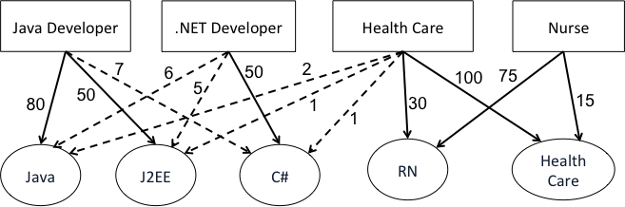
PGMHD

Slide 11
Ambiguity Detection
Given the PGMHD representation, we define ambiguity score for term t as:
A(t) = |{i: P(t,C’) > 0}|
A search keyword t is candidate to be ambiguous if A(t) > 1 .
Civil Engineer
Software Engineer
Architict

Slide 12
Resolve Ambiguity

Slide 13
Experiment and Results
We ran our experiment using 1.6 billion search logs.
Each search log containing one or more keywords supplied by
a user to search for jobs on CareerBuilder.com.
We used a distributed version of PGMHD.
The experiment was run on a Hadoop cluster with 69 data
nodes, each having a 2.6 GHz AMD Opteron Processor with
12 to 32 cores and 32 to 128 GB RAM.

Slide 14
Initial Results (Sensetivity)
Our experiments show that the system was initially so sensitive at detecting nuances in meaning.
Some search terms were detected as ambiguous due to being commonly used across multiple similar classes.
For example, the classes “Marketing Manager” and “Account Executive” are semantically very similar to each Other.
“Marketing” was detected as ambiguous term!

Slide 15
Resolve sensitivity
To overcome this problem, we applied hierarchical clustering to measure the similarity between classes.
We represent each class as a vector containing the search terms used by the users within that class.
Then we applied the Euclidean distance to measure the distance between the classes.
The result of this hierarchical clustering was the merging of classes with distances less than a specific threshold.

Slide 16
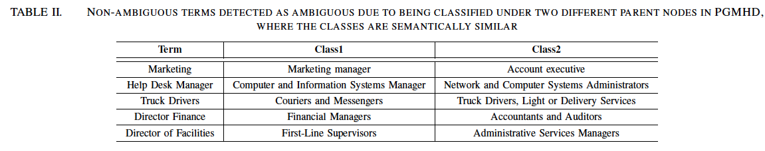

Slide 17
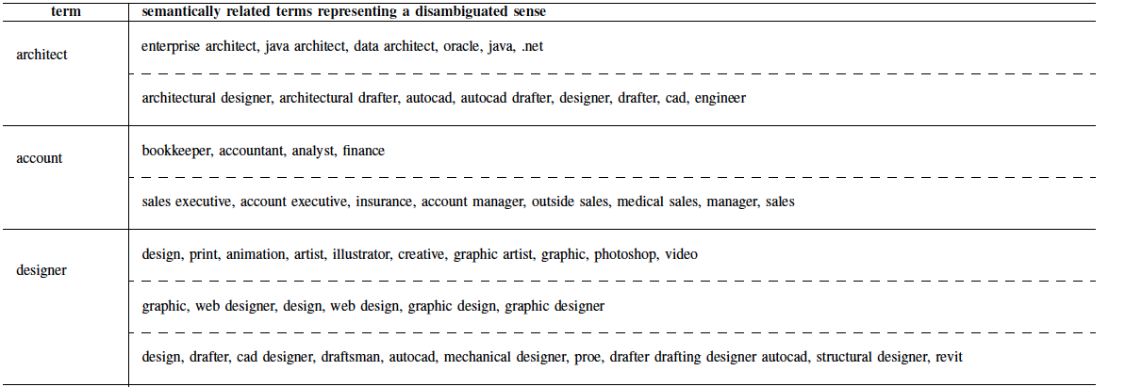
Sample of Final Results

Slide 18
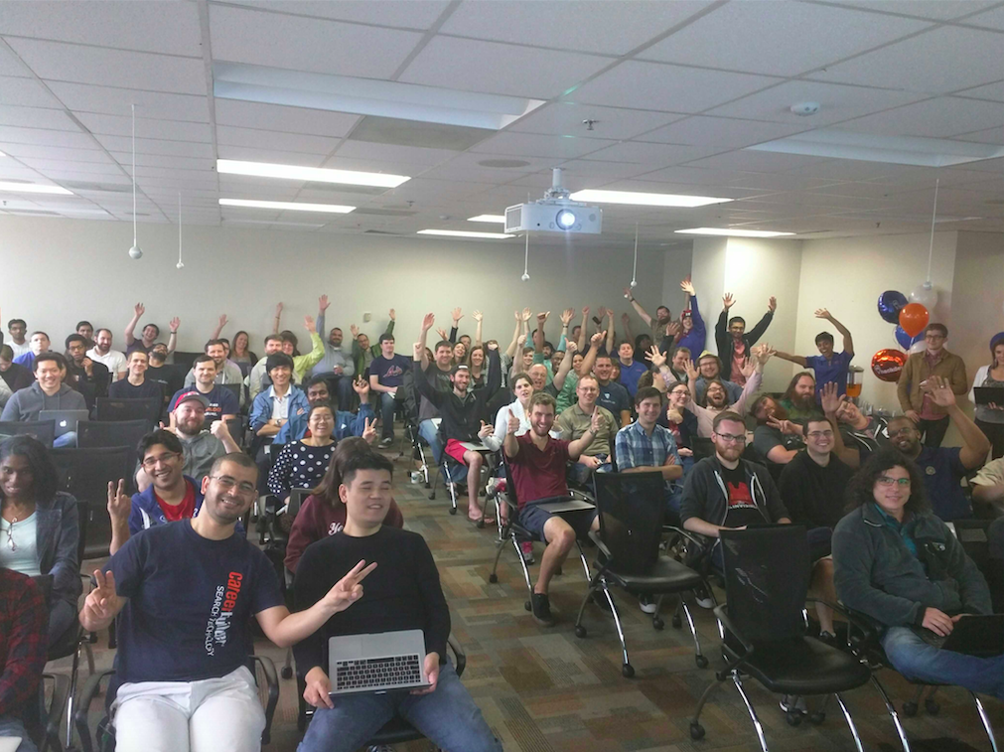
Thank you!
Yes! We are Hiring. If interested come and talk to us

