Slide 1
PhD Dissertation Defense
Scaling Up Machine Learning Algorithms to Handle Big Data
By
Khalifeh AlJadda
Advisor: Professor John A. Miller
Dec-2014
Computer Science Department University of Georgia

Slide 2
Outline
Introduction
Related Work
Motivation
Model Structure
MS Annotation using SAGE
Discovering Semantically Related Search Terms
Discovering Semantically Ambiguous Search Terms
Conclusions and Future Work

Slide 3
Introduction
Machine learning algorithms are very useful in many disciplines like speech recognition, bioinformatics, recommendations, decision making, etc.
Machine learning algorithms gain more importance in the big data era due to their ability to discover insights and hidden patterns which no other techniques can discover given massive data sets.
The bottleneck of the major machine learning algorithms in the big data era, is scalability.
Apache foundation adopted two projects that scale up machine learning algorithms to handle big data through Parallelization:
  Apache Mahout
  Apache Spark (Mlib)

Slide 4
Cont..
Scaling up machine learning algorithms can be achieved using two techniques:
  Parallelization
  Extension to overcome the scalability limitations.
Google researchers proposed Continuous Bags-of-Words (CBOW) model as an extension to the feedforward Neural Network Language Model (NNLM) by removing the non-linear hidden layer which caused most of the complexity of the original model.
This extension allows the new model to handle big data efficiently, which the original model was not suitable for.

Slide 5
Related Work
Probabilistic graphical models (PGM) consist of a structural model and a set of conditional probabilities.
Graphical models can be classified into two major categories:
  (1) directed graphical models (Bayesian networks).
  (2) undirected graphical models (Markov Random Fields).
A Bayesian Network consists of two components:
  a DAG representing the structure
  a set of conditional probability tables (CPTs)

Slide 6
Motivation
MS²
MS³
MS¹
MS1
1300
2,979,334
13000* 2,979,334 =
3,873,134,200
MS2
 | Frag1 | Frag2 | ..
GOG1
GOG2
…
MS3

Slide 7
PGMHD Model Structure
GOG1
GOG2
MS1
50
20
50
20
40
30
MS2
50
F4
F5
F3
F6
F1
F2
15
10
10
20
15
MS3
5
F10
F11
F7
F9
F8

Slide 8
MS Annotation Using SAGE
Several algorithms have been developed in attempts to
(semi)automate the process of glycan identification by interpreting
Mass Spectrometric data.
Non of these algorithms utilizes machine learning to improve the quality of the MS annotations.
We consider the MS annotation as multi-label classification problem.
PGMHD was customized to handle this problem as Smart Annotation Enhancement Graph (SAGE)
SAGE is trained using the output of GELATO

Slide 9
SAGE and GELATO

Slide 10
GOG1
GOG2
50
20
50
20
40
50
30
F4
F5
F3
F6
F1
F2
15
10
20
15
5
F9
F10
F7
F8

Slide 11
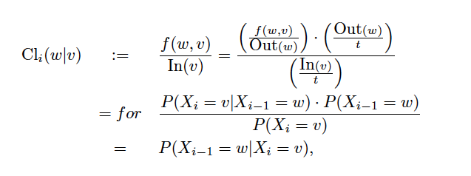
Cont..
We define the following classification score using PGMHD:
P(GOG1 | F1,F3,F7) = P(GOG1|F1) * P(GOG1|F3) * P(F3|F7)) = 50/50 * 20/60 * 10/25

Slide 12
MS Annotation’s Experiment and Results
Data Set:
  We annotated 3314 MS scans of pancreatic cancer samples using GELATO.
  An expert manually approved 1990 scan annotations which we used to train and test our model.
  The size of the training data is 1779 scans’ annotations and 121 scans’ annotations for testing.
Experiment Setup:
We compared PGMHD against leading classifiers including:
  Naïve Bayes
  Bayesian Network
  SVM
  Decision Tree
  K-NN
  Neural Network
  RBF
We used Mulan which is an extension to Weka for multi-label classification.

Slide 13
Results

Slide 14
Cont..

Slide 15
Cont..

Slide 16
Cont..

Slide 17
Synthesized Data Set
Our focus on this experiment is on the memory usage.
We synthesized a data set with:
  6776 instances for training
  392 instances for testing
  2952 features
  1340 classes

Slide 18
Results

Slide 19
Discovering Semantically Related Search Terms
We would like to create a language-independent algorithm for modeling semantic relationships between search phrases.
It should provides output in a human-understandable format.
Search terms usually are single phrases (No long sentences or paragraphs).
CBOW is not suitable in this case.
NLP techniques are not language-independent, so they are not an option.

Slide 20
Search Terms Representation
Java Developer
.NET Developer
Nurse
Health Care
3
10
1
50
10
5
50
100
15
Java
J2EE
C#
Care giver
RN
Senior Home

Slide 21
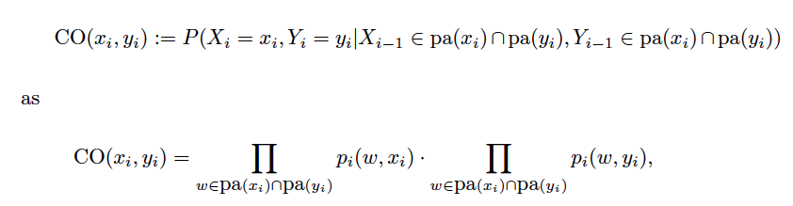
Probabilistic Similarity Score

Slide 22
Java Developer
.NET Developer
Nurse
Health Care
3
10
1
50
10
5
50
100
15
Java
J2EE
C#
Care giver
RN
Senior Home
P(Java,J2EE| Java Developer) = P(Java|Java Developer) * P(J2EE|Java Developer)
= 5/18 * 10/18
P(Java,C#|Java Dev) = P(Java|Java Dev) * P(C#|Java Dev) = 5/18 * 3/18

Slide 23
Experiment and Results
1.6 billion search logs (searches conducted by users) provided through CareerBuilder.com.
A distributed version of PGMHD was implemented using Hadoop Map/Reduce.
A cluster of 69 data nodes each has up to 128 GB RAM used to run the experiments.
The execution time was about 45 minutes.

Slide 24
Results
3000 pairs (search term, related search term) were sent to data analysts to provide a feedback if the pairs are related or not.
The data analysts confirm that %80.3 are related.
Upon the results, the model has been used in production for discovering the semantically related search terms.

Slide 25
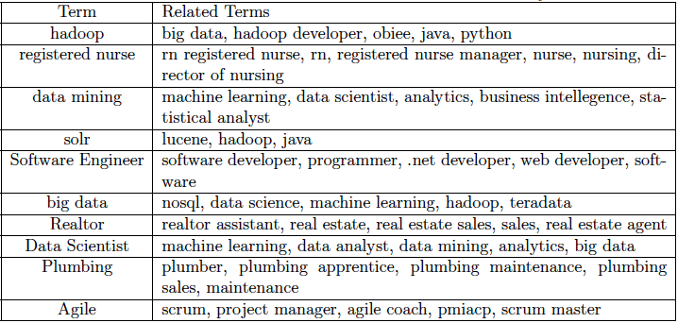
Cont..

Slide 26
Discovering Semantically Ambiguous Search Terms
The semantic ambiguity of a keyword can be defined as the likelihood of seeing different meanings of the same keyword in different contexts.
The techniques mentioned in the literature focuses on utilization of ontologies and dictionaries like Wordnet.
Those solutions are not applicable when the keywords are from a domain like job search. For example, “Architect” refers to “Software Architect” and “Construction Architect” which wouldn’t be defined in an English dictionary.

Slide 27


Slide 28
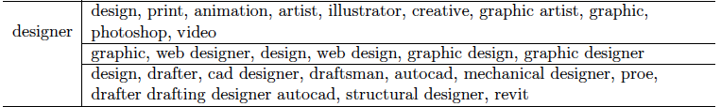

Slide 29
Conclusions and Future Work
Machine learning algorithms are considered the core of data analysis and data driven computation.
These algorithms exhibit scalability limitation which makes it difficult to
utilize them with big data.
we propose a scalable probabilistic graphical model PGMHD which can be considered as an extension to the well known machine learning model Bayesian Network.
The proposed model is used in production at CareerBuilder.com for discovering semantically related keywords, as well as, semantically ambiguous keywords.
The proposed model is successfully customized to automate the process of MS annotation which the results shows how powerful it is for that purpose.

Slide 30
Publications
http://www.aljadda.com/publications.html

Slide 31
Questions

